Slide 1
Healthcare Data Analysis
Uncovering Insights in Healthcare Data: A Comprehensive Exploration

Slide 2
Business Understanding and Overview
In this Healthcare Data Analysis EDA, we embark on an exploration of a comprehensive dataset encompassing patient information, medical conditions, and appointment histories. Our key objectives for this analysis are to:
Understand Patient Behavior: Gain insights into patient behavior patterns, such as attendance trends and responsiveness to SMS reminders.
Uncover Health Condition Patterns : Explore the distribution of health conditions, including diabetes, hypertension, and alcoholism, among patients.
Evaluate Socioeconomic Factors : Investigate the impact of socioeconomic factors, such as scholarships, on appointment attendance.
Examine Neighborhood Variances : Analyze the influence of neighborhoods on patient engagement, highlighting disparities in different regions.
Identify Potential Opportunities : Discover opportunities for improving healthcare service effectiveness and patient engagement.
By thoroughly examining these aspects, we aim to enhance our understanding of healthcare dynamics and contribute to informed decision-making in the healthcare sector.

Slide 3

Understanding the data

Slide 4
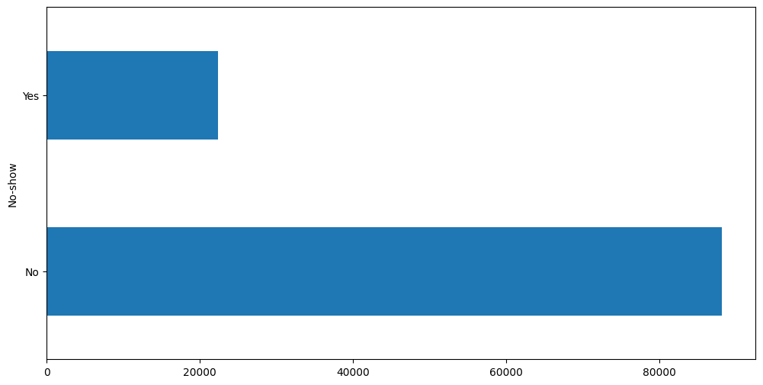
Target variable
Target Variable: "No-show"
Definition: Indicates whether a patient attended their scheduled appointment or not.
Values:
"No": Patient showed up for the appointment.
"Yes": Patient did not show up for the appointment.
Objective: To understand factors influencing appointment attendance and improve healthcare service effectiveness.

Slide 5
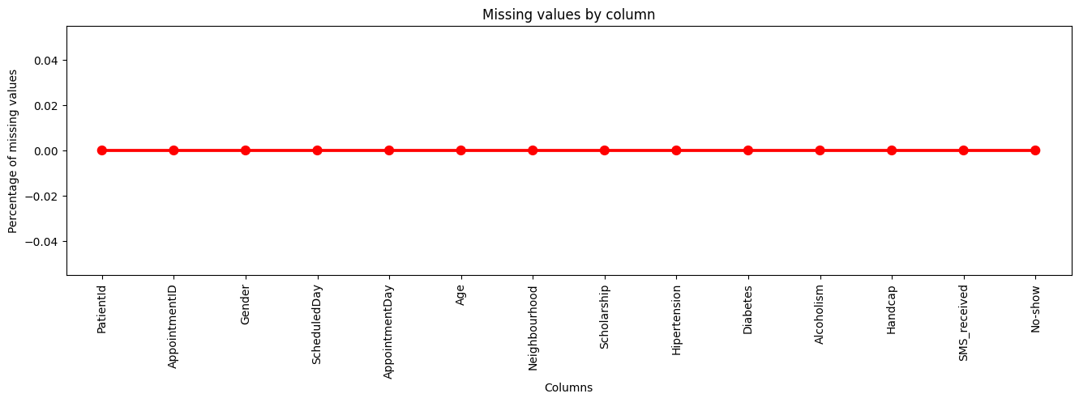
Missing Data
Data Integrity: The dataset exhibits exceptional data integrity.
No Missing Values: Notably, there are no missing values in any of the dataset's columns.
High-Quality Data: This data completeness ensures the reliability and robustness of our analysis.
This succinctly communicates that the dataset is complete and free of missing values, underlining the quality of the data used for analysis.

Slide 6
Univariate Analysis

Slide 7
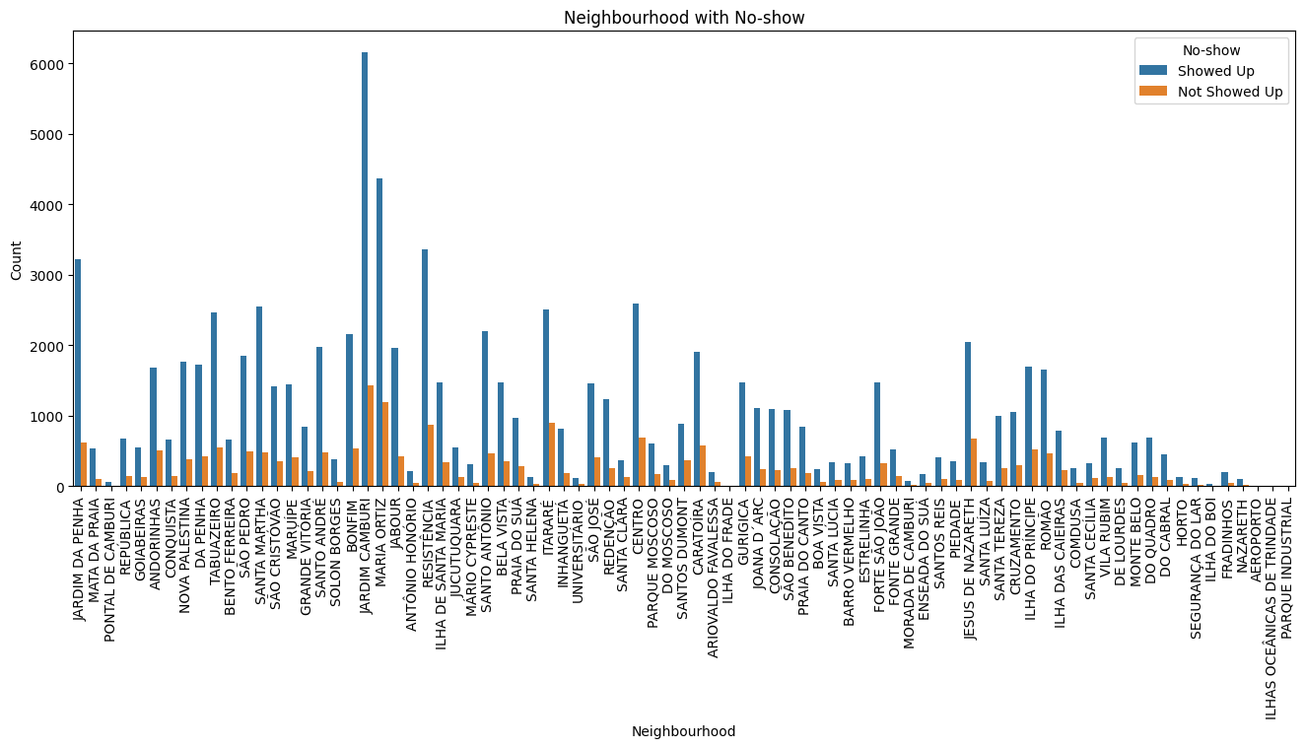
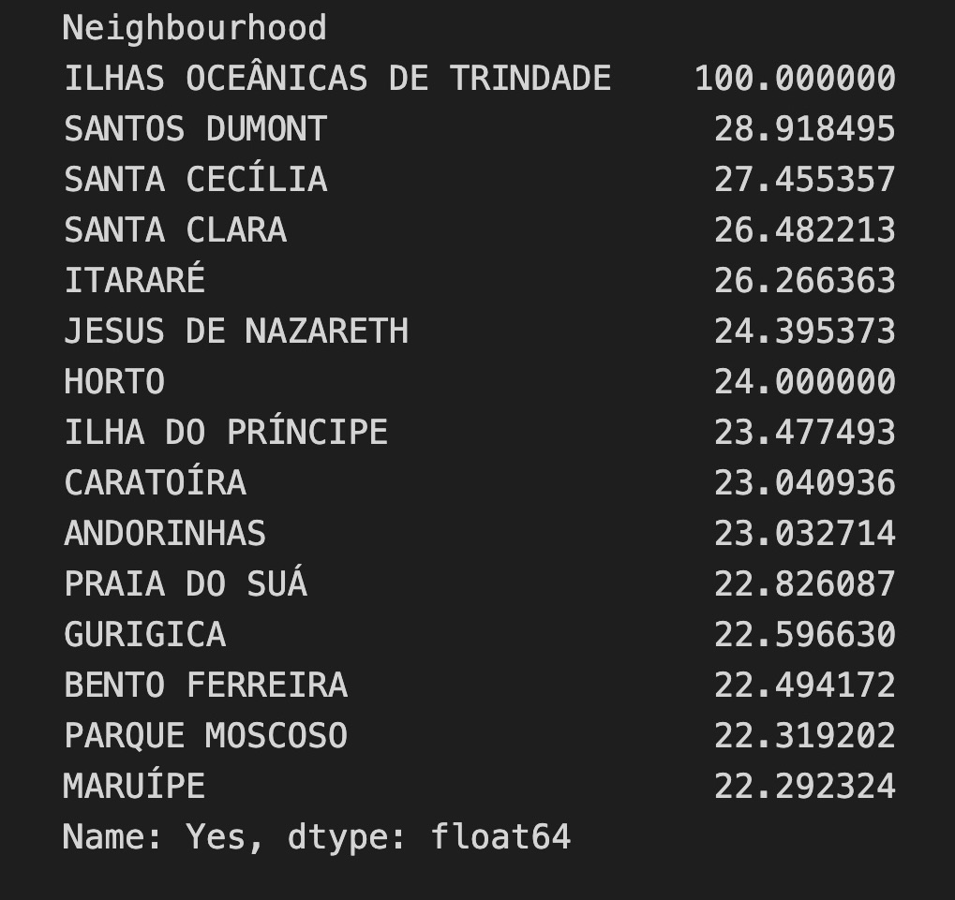
neighborhood
Key Findings:
The following neighborhoods have a higher likelihood (23% - 28%) of patients not showing up for appointments:
SANTOS DUMONT
SANTA CECÍLIA
SANTA CLARA
ITARARÉ
JESUS DE NAZARETH
HORTO
ILHA DO PRÍNCIPE
CARATOÍRA
ANDORINHAS
Implication: Understanding these neighborhood-specific trends can guide targeted interventions to improve appointment attendance rates.

Slide 8
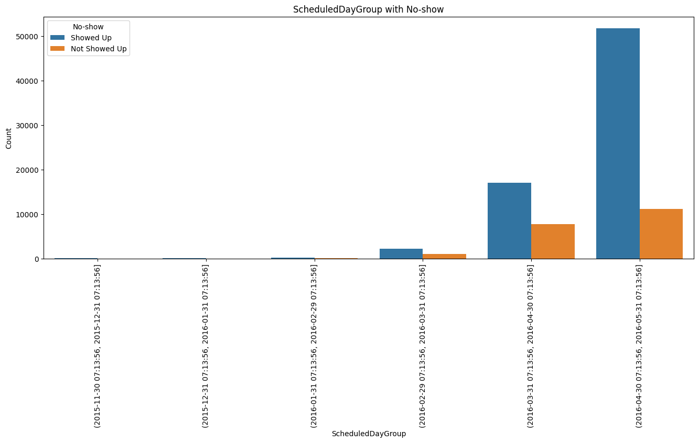
Scheduled Day
Key Findings:
Appointments scheduled between February 29, 2016, and April 30, 2016, exhibit a higher likelihood (34%) of patients not showing up.
Implication: Recognizing this time-specific trend can inform strategies to enhance appointment attendance during this period.

Slide 9
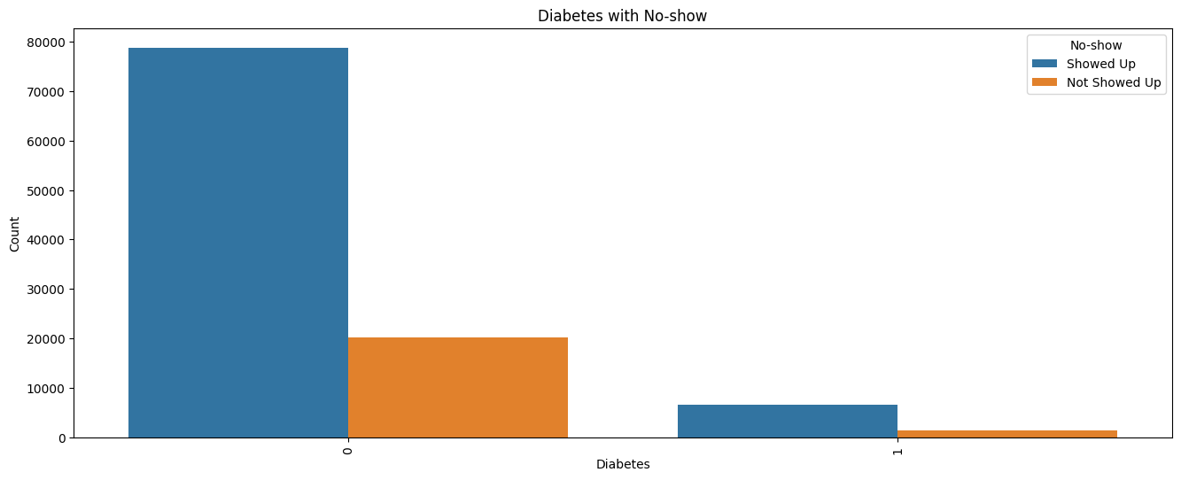
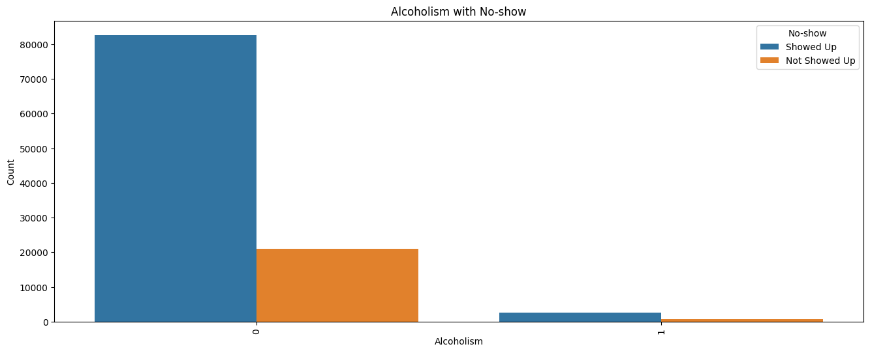
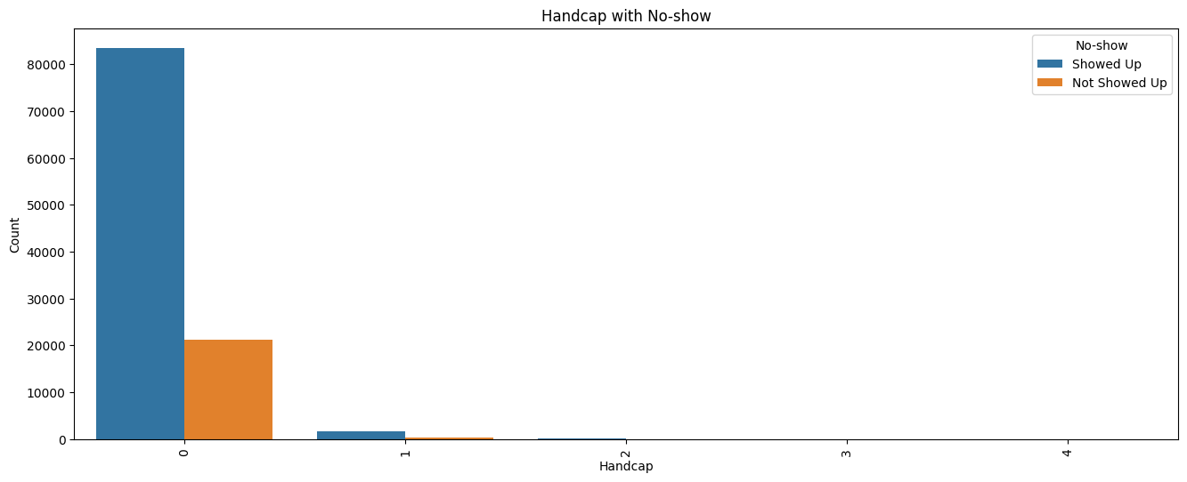
Diabetes, Alcoholism, and Handicap
Key Findings:
Diabetes patients are more likely (25%) not to show up for appointments.
Alcoholic patients are more likely (25%) not to show up for appointments.
Patients with a mild level of handicap or disability are more likely (25%) not to show up for appointments.
Implication: Recognizing these correlations can guide targeted support and reminders for at-risk patient groups, ultimately improving appointment attendance.

Slide 10
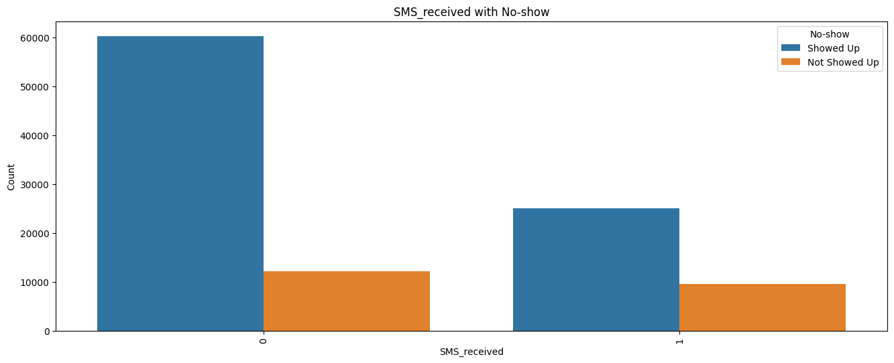
SMS Received
Key Findings:
Patients who receive SMS reminders are paradoxically more likely (28%) not to show up for appointments.
Implication: This unexpected trend suggests the need to investigate the effectiveness of SMS reminders and explore alternative methods for enhancing appointment attendance.

Slide 11
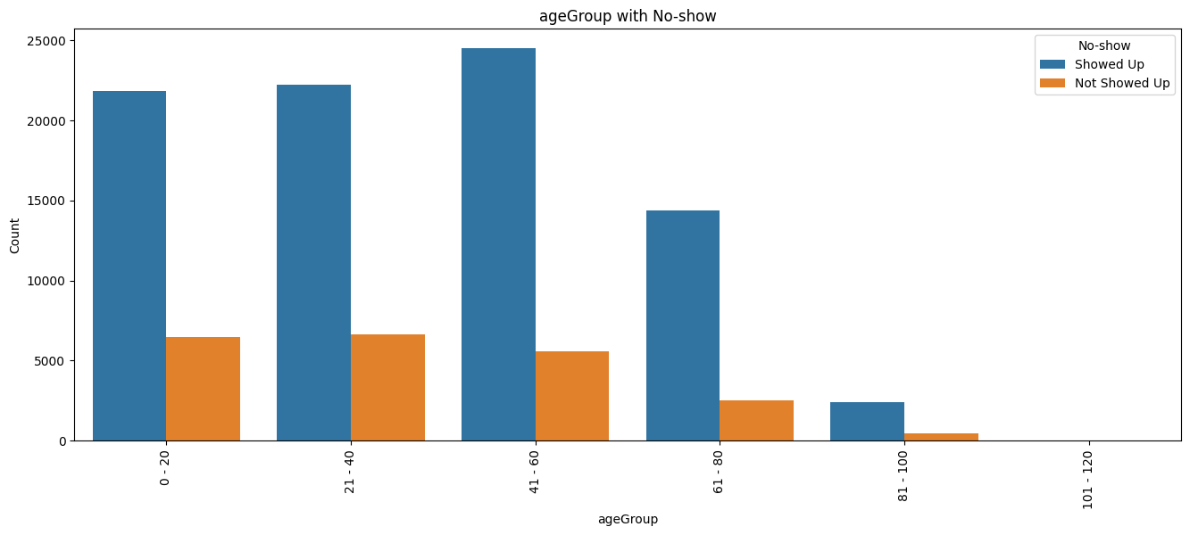
Age Group
Key Findings:
Patients in the age group 0 to 40 are more likely (25%) not to show up for appointments.
Implication: Understanding this age-related trend can aid in tailoring appointment reminders and interventions for younger patients to improve attendance rates.

Slide 12
Bivariate Analysis

Slide 13
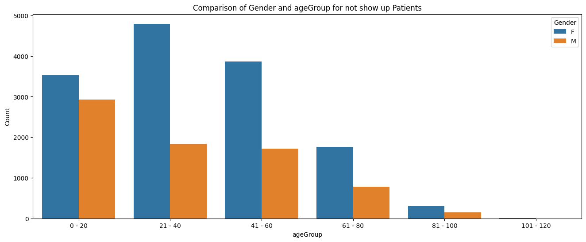
Gender and Age Group
Key Findings:
In the age group 0-20, 45% of males and 55% of females are more likely not to show up for appointments.
In the age group 21-40, 28% of males and 72% of females are more likely not to show up.
In the age group 41-100, 32% of males and 68% of females are more likely not to show up.
Implication: Recognizing gender-based variations within age groups can inform gender-specific strategies for appointment reminders and interventions.

Slide 14
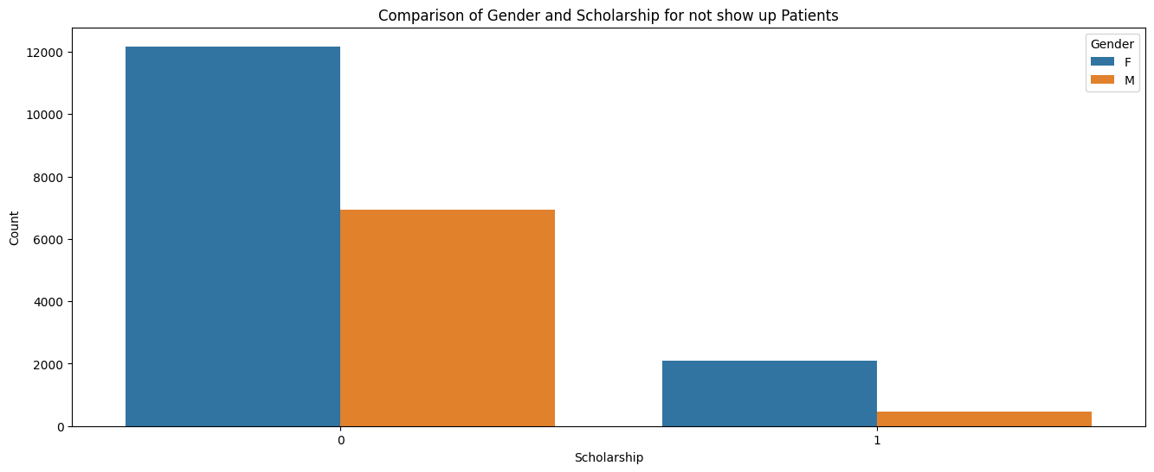
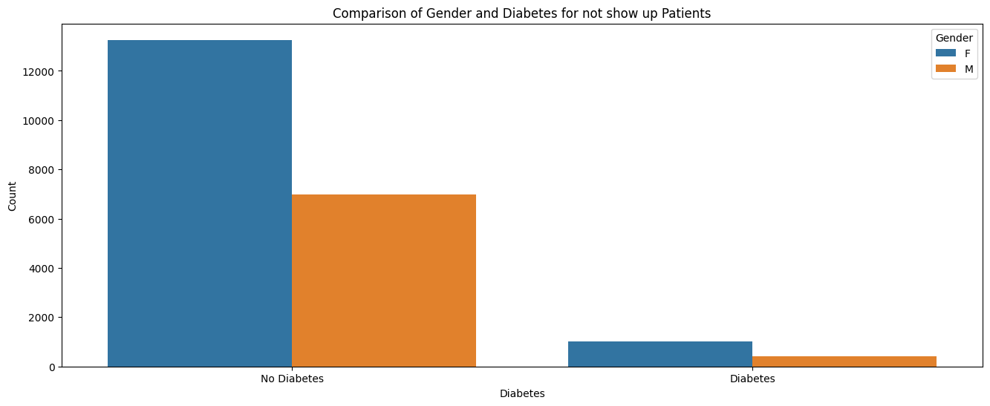
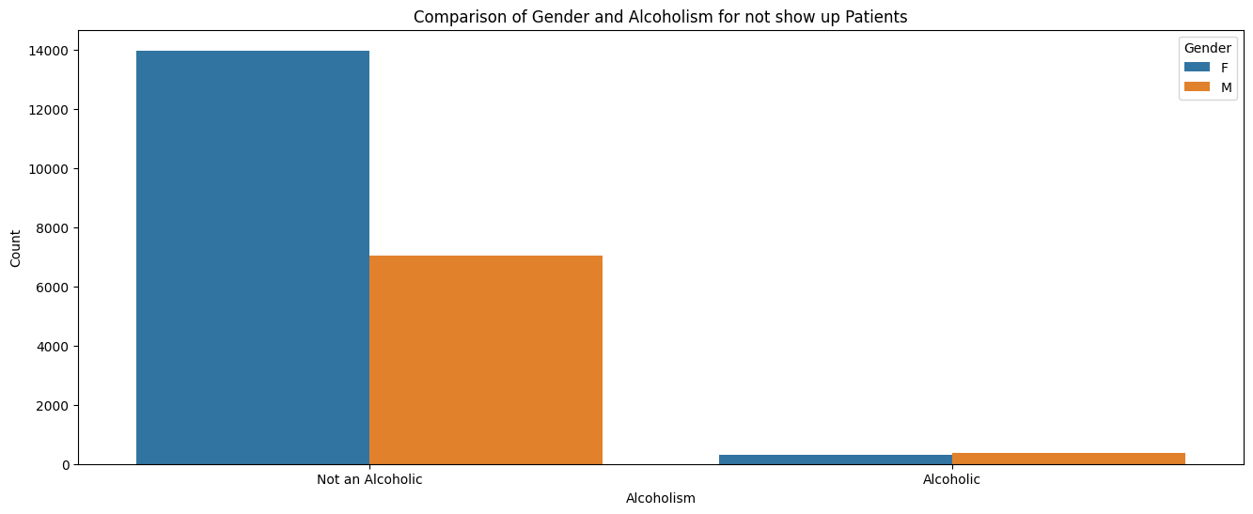
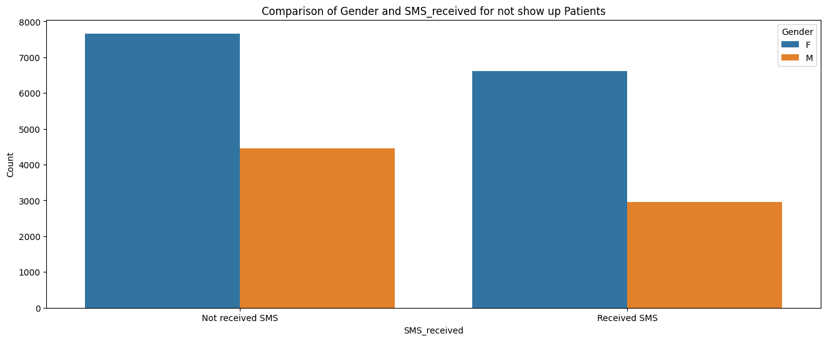
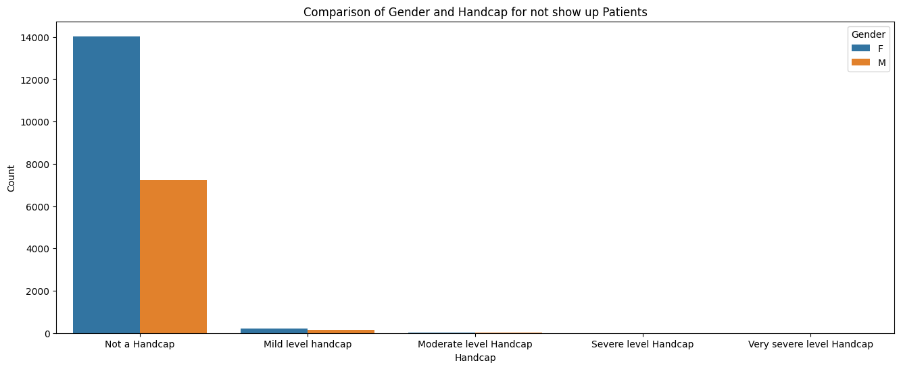
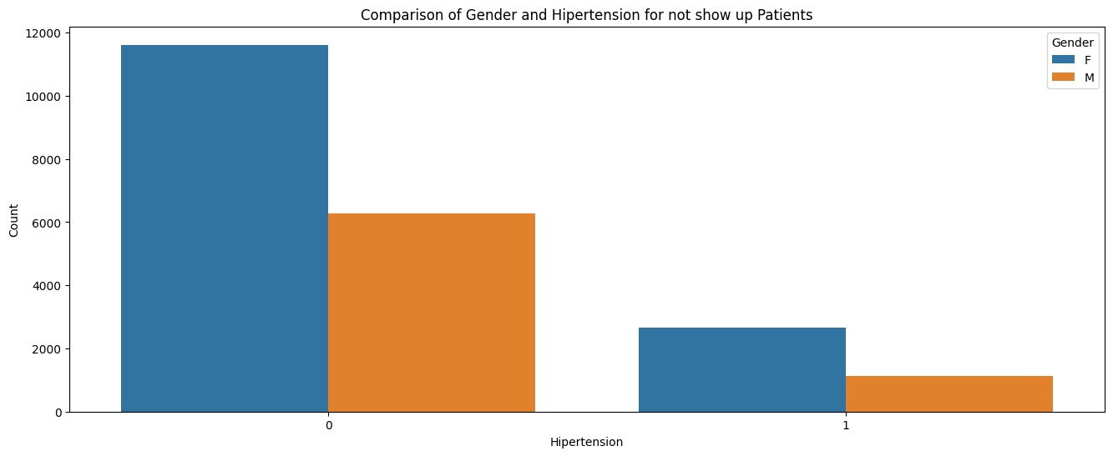
Gender with Other Factors

Slide 15
Gender with other factors
Key Findings :
Scholarship:
Females with or without a scholarship are more likely not to show up for appointments.
Hypertension:
Females with or without hypertension are more likely not to show up for appointments.
Diabetes:
Female diabetic patients are more likely not to show up compared to non-diabetic patients.
Alcoholism:
Non-alcoholic females are more likely not to show up.
Handicap:
Females without a handicap are more likely not to show up.
SMS Received:
Females, regardless of receiving SMS reminders, are more likely not to show up.
Implication: The consistent trend of females being more likely not to show up across various factors underscores the importance of gender-specific strategies for appointment reminders and interventions.

Slide 16
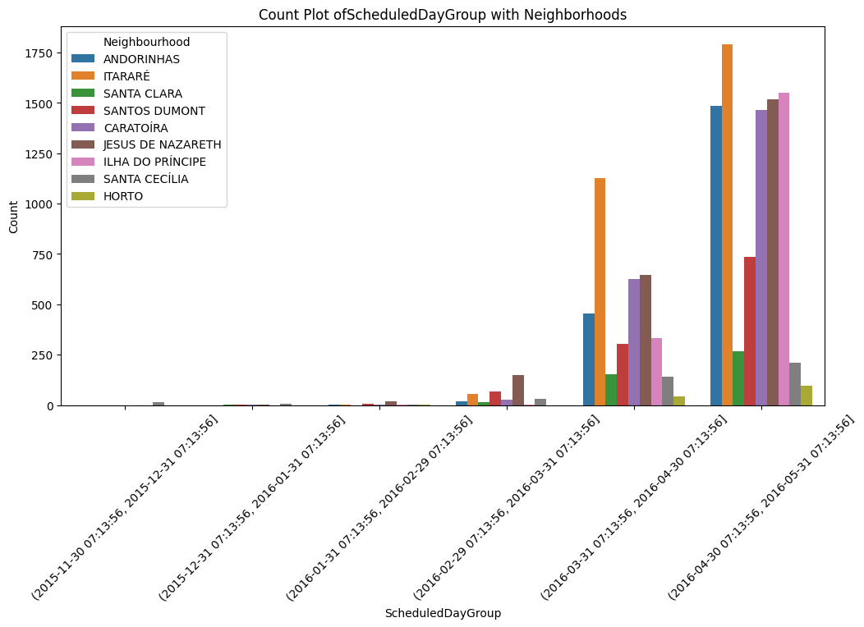
Neighborhood with Scheduled Day
Key Findings :
Scheduled from 2016-02-29 to 2016-03-31 for an appointment:
Neighborhoods with a higher likelihood of patients not showing up include JESUS DE NAZARETH, SANTOS DUMONT, and ITARARÉ.
This specific scheduling period indicates potential challenges in these neighborhoods regarding appointment attendance.
Scheduled from 2016-03-31 to 2016-04-30 for an appointment:
Neighborhoods with a higher likelihood of patients not showing up include ITARARÉ, JESUS DE NAZARETH, CARATOÍRA, ANDORINHAS, ILHA DO PRÍNCIPE, and SANTOS DUMONT.
This later scheduling period highlights a broader range of neighborhoods facing similar attendance challenges.
Scheduled from 2016-04-30 to 2016-05-31 for an appointment:
Neighborhoods with a higher likelihood of patients not showing up include ITARARÉ, ILHA DO PRÍNCIPE, JESUS DE NAZARETH, ANDORINHAS, CARATOÍRA, and SANTOS DUMONT.
These trends persist into the subsequent month, reinforcing the importance of addressing attendance issues in these areas.
Implication: Recognizing neighborhood-specific variations based on scheduling periods allows for targeted interventions and strategies to improve appointment attendance in these regions.

Slide 17
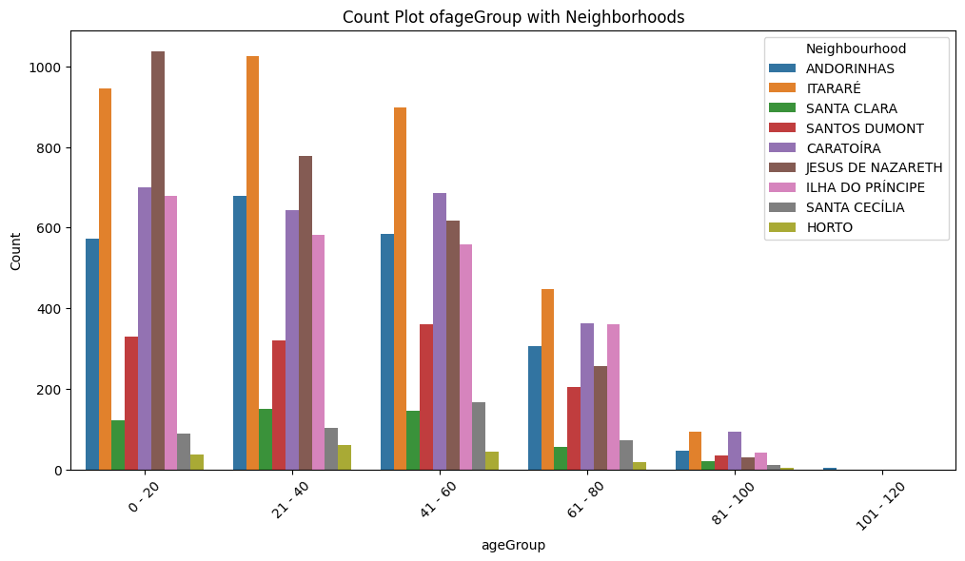
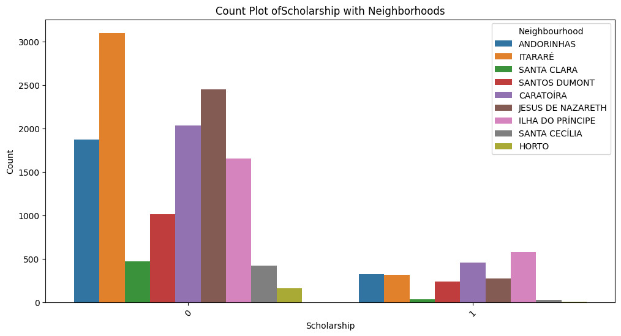
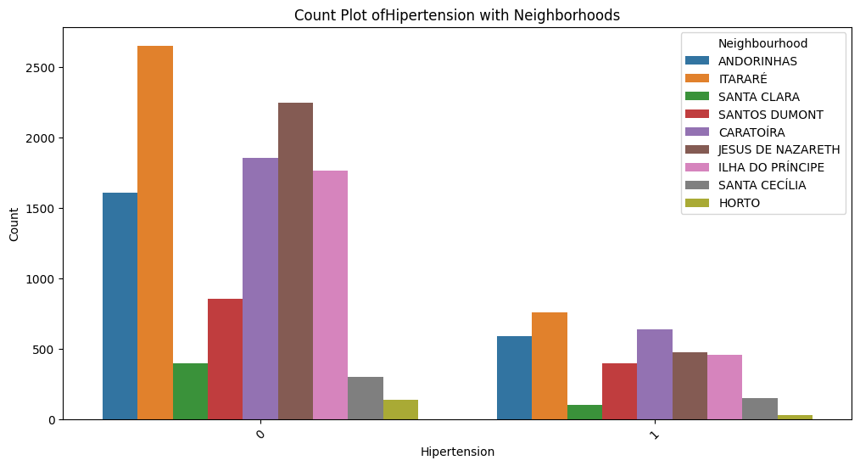
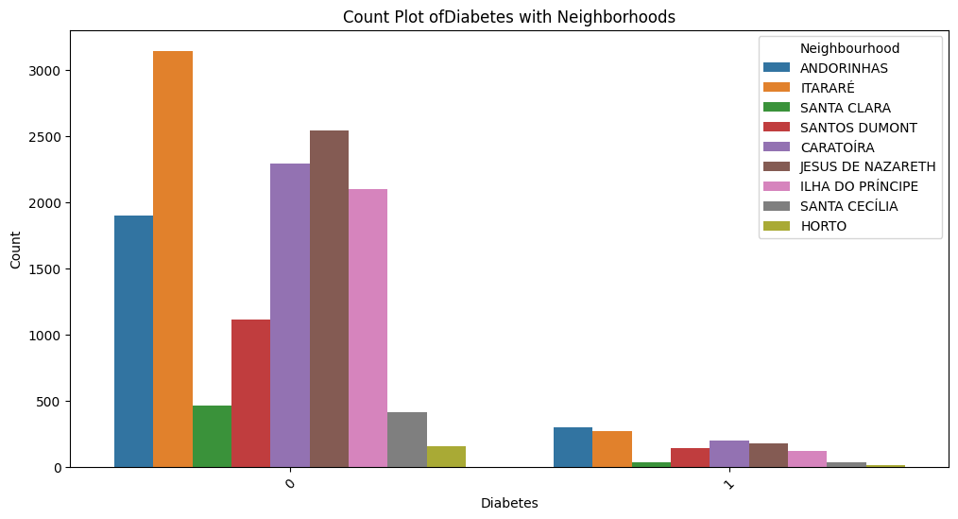
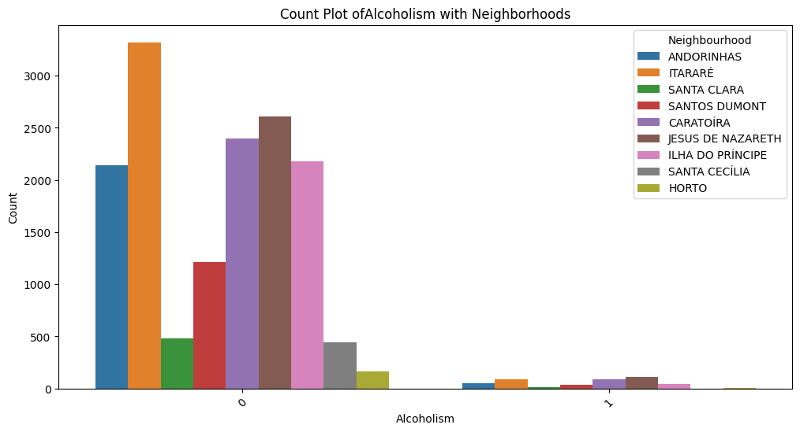
Neighborhood with Other Factors
From ITARARÉ, JESUS DE NAZARETH, CARATOÍRA, ILHA DO PRÍNCIPE, ANDORINHAS, SANTOS DUMONT:
Patients of all age groups (0-80) in these neighborhoods are more likely not to show up for appointments.
Non-scholarship patients from these neighborhoods are more likely not to show up.
Patients who don't have hypertension, diabetes, or alcoholism in these neighborhoods are more likely not to show up.

Slide 18
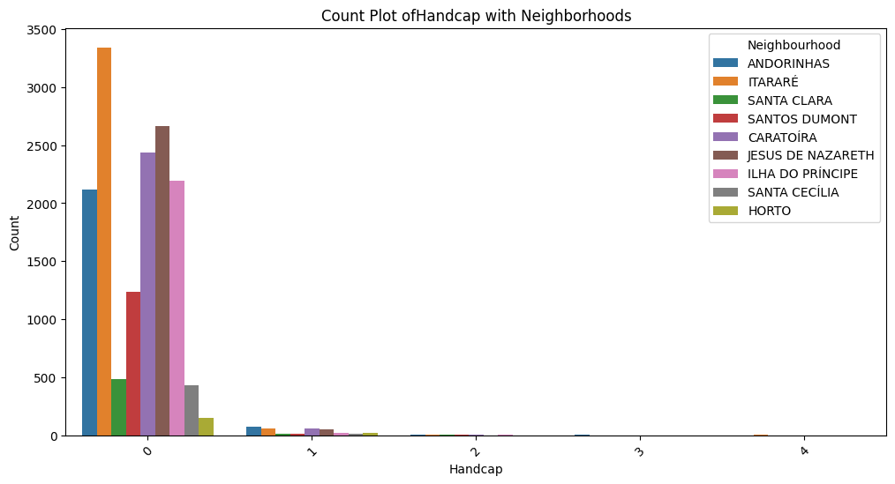
Neighborhood with Other Factors
From ITARARÉ, JESUS DE NAZARETH, CARATOÍRA, ILHA DO PRÍNCIPE, ANDORINHAS, SANTOS DUMONT:
Patients who are not handicapped in these neighborhoods are more likely not to show up.

Slide 19
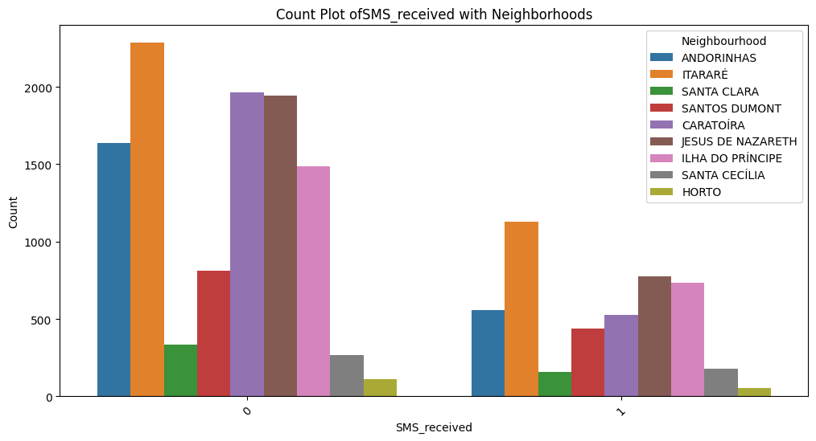
Neighborhood with SMS Received
From ITARARÉ, CARATOÍRA, JESUS DE NAZARETH, ANDORINHAS, ILHA DO PRÍNCIPE:
In these neighborhoods, both patients who receive SMS reminders and those who do not are more likely not to show up for appointments.
Implication: This finding highlights a unique challenge in these neighborhoods, where neither SMS reminders nor their absence seem to significantly impact appointment attendance. Further investigation is warranted to understand the underlying factors.

Slide 20
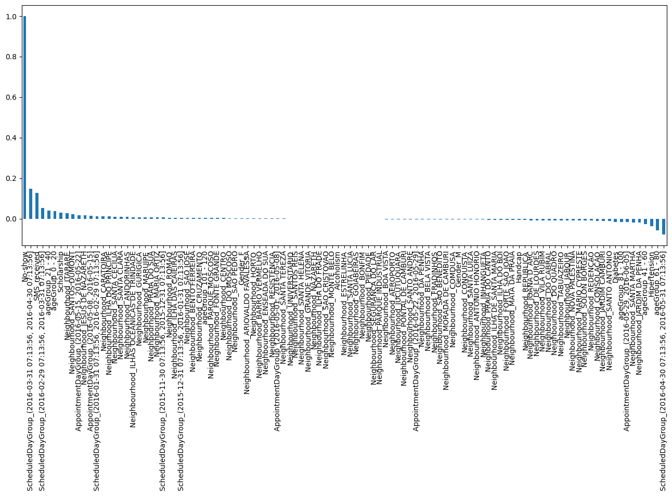
Correlation of Data with respect to “No-show”
Limited Correlation Strength: The data exhibits predominantly weak correlations, with most values falling between -0.2 to 0.2.
Limited Insights: These modest correlations suggest that the relationships between variables are not strong, indicating that additional factors might influence appointment attendance beyond what's captured in this dataset.

Slide 21


Conclusion :
Gender Influence: Females are consistently more likely not to show up for appointments across various age groups and neighborhoods, as observed in the analysis.
Neighborhood Disparities: Specific neighborhoods, including ITARARÉ, JESUS DE NAZARETH, CARATOÍRA, ILHA DO PRÍNCIPE, ANDORINHAS, and SANTOS DUMONT, exhibit higher non-attendance rates. Targeted interventions in these regions are essential.
Health-Related Factors: Patients who don't have hypertension, diabetes, are not handicapped, alcoholic, and lack a scholarship are also more likely not to show up. These health-related trends reinforce the importance of tailored interventions.
SMS Reminder Paradox: An unexpected finding is that receiving SMS reminders does not necessarily improve appointment attendance. This counterintuitive observation calls for further investigation into the effectiveness of the reminder system.
Weak Correlations: The data shows primarily weak correlations, emphasizing that appointment attendance is influenced by multiple complex factors beyond what's captured in this dataset.

